Slide 1
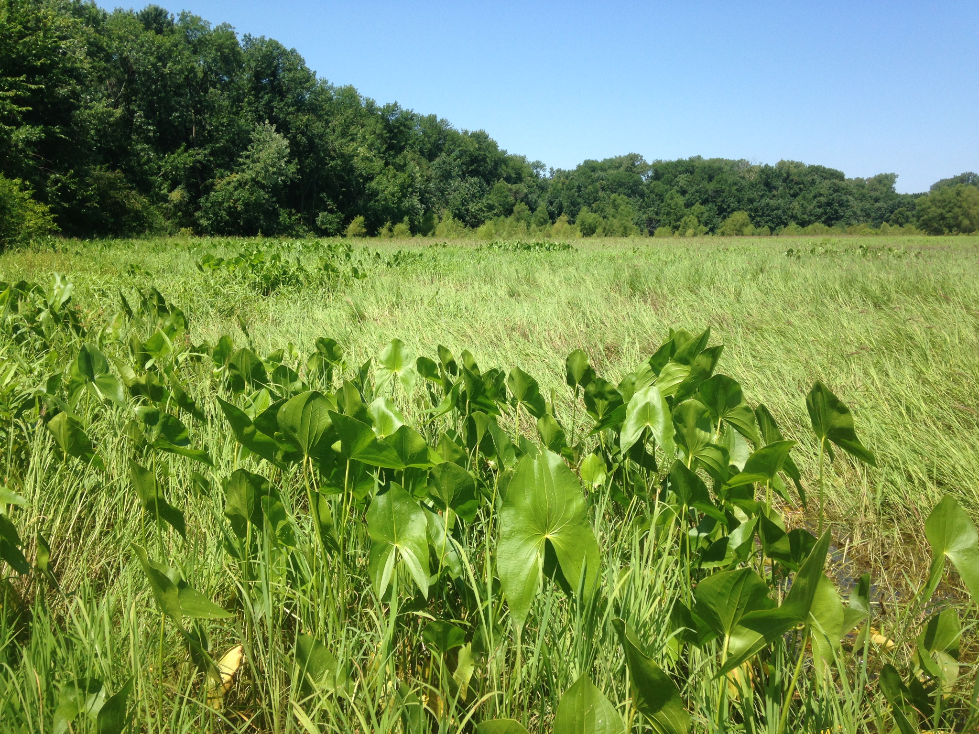
Ecosystem Benefits for WLM Action

Slide 2
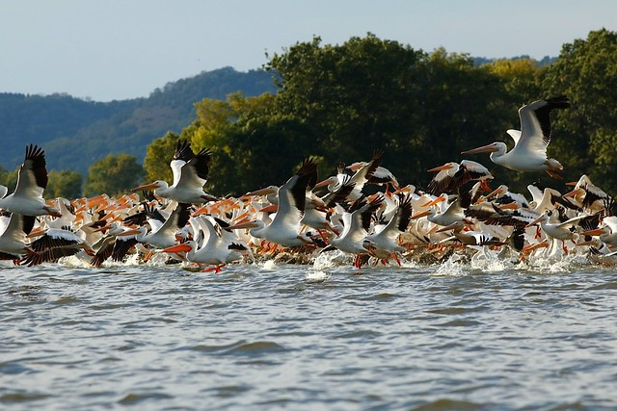
Introduction
Goals and Objectives of Ecosystem Benefits Analysis
Quantify the ecological outputs of drawdowns to better understanding the costs and benefits
Develop a comparison between WLM and UMRR Habitat Restoration and Enhancement Projects (HREPs)
Compare drawdown benefits between pools and to other ecosystem restoration actions being considered
Photo: USFWS Flickr
Notes:
Go beyond NESP report 53 2004 publication that looked at acres exposed, success rate, dredging required.

Slide 3
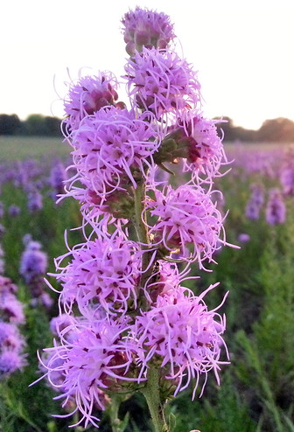
Introduction
Dabbling Duck Migration Model
Corps certified model (2013), “used to quantify and evaluate fall migration habitat quality on large river systems and associated backwater for dabblers including mallard, gadwall, pintail, blue-winged and green-winged teal, wigeon, and wood duck.”
Model variables include:
Distance to bottomland hardwoods
Distance to cropland and cropland practices
Water depth 4-18 inches in the fall
Water depth <4 inches in the fall
Percent open water
Plant community diversity
Important food plant coverage
Percent of area containing loafing structures
Structure to provide thermal protection
Disturbance in the fall
Visual barriers
Photo: USFWS Flickr
Notes:
Might mention that it has been used successfully to evaluate multiple HREP projects.

Slide 4
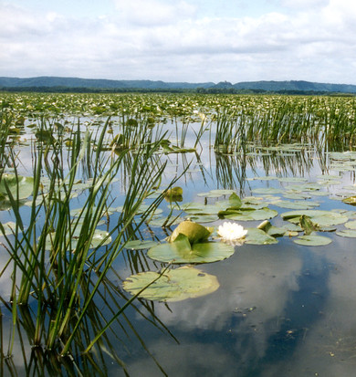
Introduction
Dabbling Duck Migration Model Variables of Interest
Model variables include:
Distance to bottomland hardwoods
Distance to cropland and cropland practices
Water depth 4-18 inches in the fall
Water depth <4 inches in the fall
Percent open water (variable 5)
Plant community diversity (variable 6)
Important food plant coverage (variable 7)
Percent of area containing loafing structures
Structure to provide thermal protection
Disturbance in the fall
Visual barriers
Photo: USFWS Flickr

Slide 5
Methodology for Calculating Model Scores for Future with Water Level Management
Assumptions
We assume that existing (no WLM) unvegetated or sparsely vegetated areas that become exposed under drawdown conditions will grow Emergent Aquatic Vegetation
We assume that other existing (no WLM) areas that become partially exposed under drawdown conditions will also see some improvement, specifically an evenly split growth rate of Submersed Aquatic Vegetation and Rooted Floating Aquatics
For variable 7 - important food plant coverage, we assume that ALL new acres of vegetation exposed from drawdowns contain important waterfowl food plant species
Notes:
First step was to make some assumptions about how vegetation would grow in relation to the dewatered areas.
For important food plant species, this assumption is based on review of the results of past drawdowns in the upper pools and the monitoring reports of Pools 24-26.

Slide 6
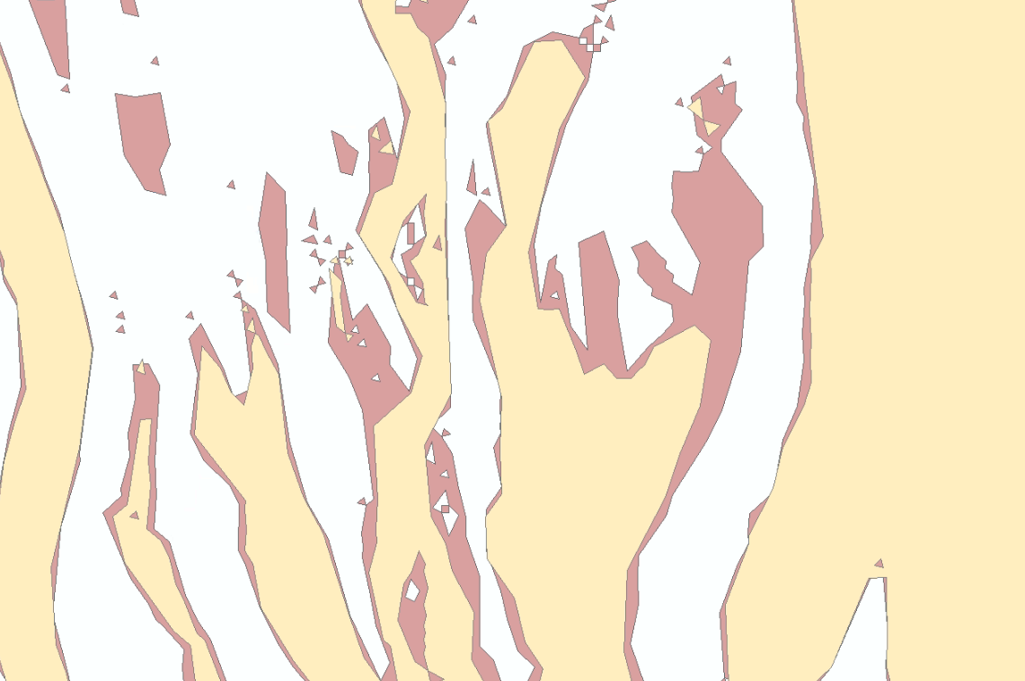

Methodology for Calculating Model Scores for Future with Water Level Management
Determine exposed areas from drawdowns
Normal Water Surface Shape
Drawdown Water Surface Shape
Areas Exposed from Drawdown
Pool 10: 2’ Drawdown
Notes:
Data used:
Water surface shape of each pool for each drawdown condition and normal conditions
Acreage Amounts of Land Classifications from the UMRR LTRM 2010 Land Cover/Use geographic shapefiles

Slide 7
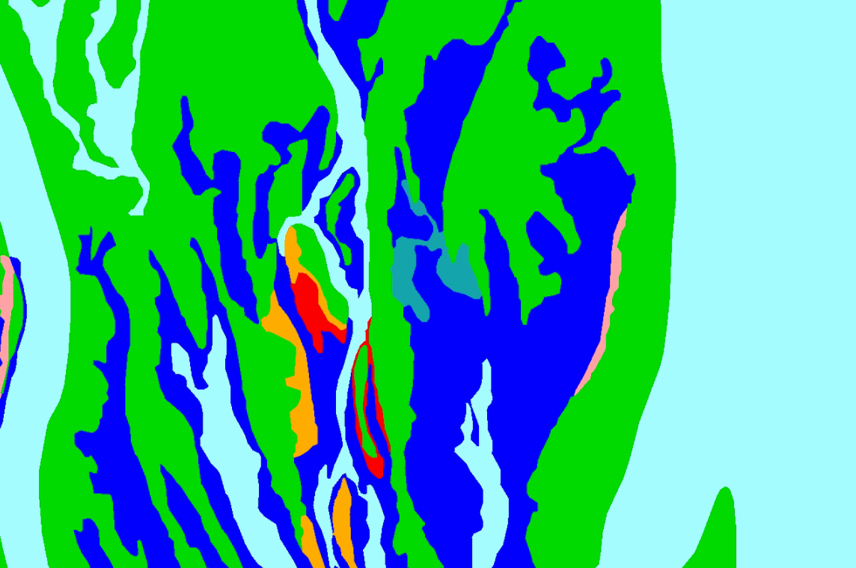
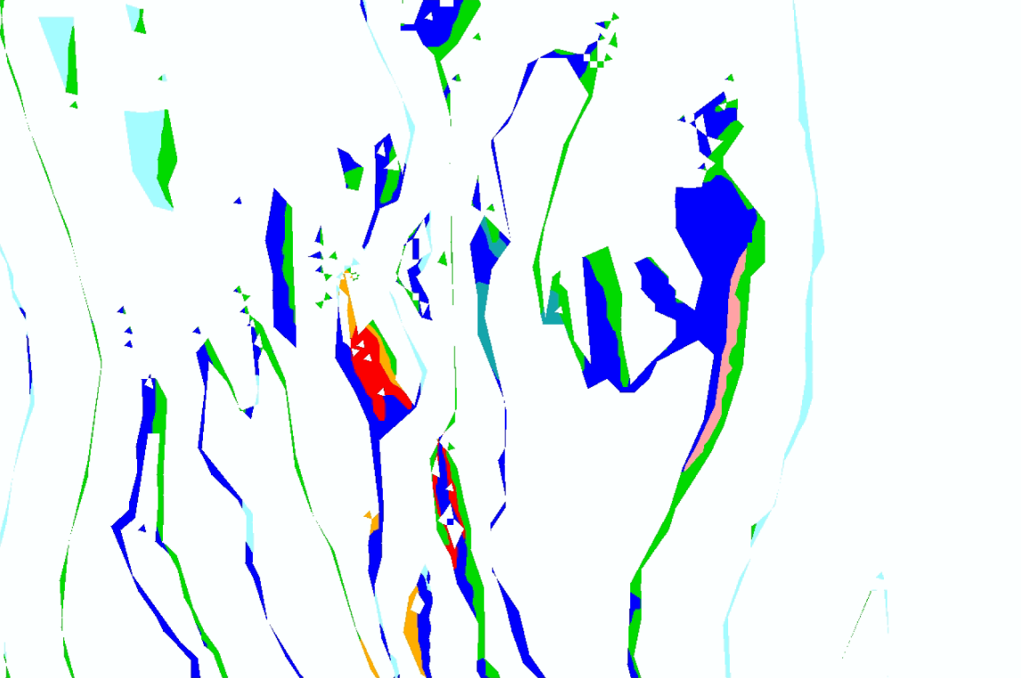
Methodology for Calculating Model Scores for Future with Water Level Management
Calculating predicted vegetation improvement
Overlay
Exposed Acreages of Land Classifications (Different types of vegetation)
Areas Exposed from Drawdown
2010 UMRR LTRM Land Cover/Use Shapefile
Pool 10: 2’ Drawdown
Notes:
The idea here is to find out what is CURRENTLY in the areas that would be exposed during a drawdown. The simplest way to make assumptions would have been to go with a 1:1 improvement of vegetation with the acres exposed.
We decided to try something a little more complicated, which brings the estimate down in areas where vegetation is already good.

Slide 8
Methodology for Calculating Model Scores for Future with Water Level Management
First Step: Calculating predicted vegetation improvement
Exposed Areas Cutout of
Land Classification Data
New Emergent Vegetation Prediction
If already good vegetation (>33%) ---> No Change
If little or no vegetation (<33%) ---> Converts to Emergent Vegetation
Notes:
The land class data fortunately contains some info not only about the communities, but also about the vegetation density. (10-33%, 24-66%, 66-90% and 90%+) We used the lowest cutoff, so that if vegetation was more dense than 33% according to the land class data, that acreage wasn’t considered “converted” to becoming new aquatic vegetation.
This really meant we were tailoring the prediction to each pool and account for existing conditions better. Therefore, pools with lots of existing, dense aquatic veg aren’t going to see as much of a gain.

Slide 9
Methodology for Calculating Model Scores for Future with Water Level Management
First Step: Calculating predicted vegetation improvement
Assumption: Additional improvements will occur in existing aquatic veg beds and outside of the exposed area
Total Acres of New Emergent Vegetation
x 50%
x 50%
Total Acres of New Rooted Floating Aquatics
Total Acres of New Submersed Aquatic Vegetation
Notes:
At the same time, we felt this was a little too constraining, as the whole idea is not just to grow new emergent veg solely on exposed areas, but to support existing beds and support other vegetation types, even if not as strongly. What about the areas that aren’t dewatered but where the photic zone is increased to the point of improving conditions. So we decided to also assign some lesser benefits to SAV and RAF.
Much less information to go off of here and I would bet some mixed feelings on this one. If you have trouble with assuming that some SAV and RAF would be benefited, this could be changed to EV too and we would still see many of the benefits.
Decided to make reduced, simplified and conservative estimates by carrying forward the same total acreage of minimally vegetated exposed areas, and assume that amount of area would improve by approximately 50% for each veg type.
In addition, we expect benefits to areas that aren’t exposed, but are made temporarily shallower by the drawdown.
Assuming that approximately the same area as is exposed is positively impacted.
For simplicity we are simply assuming a 50/50 split of:
Submersed Aquatic Vegetation
Rooted Floating Aquatics

Slide 10
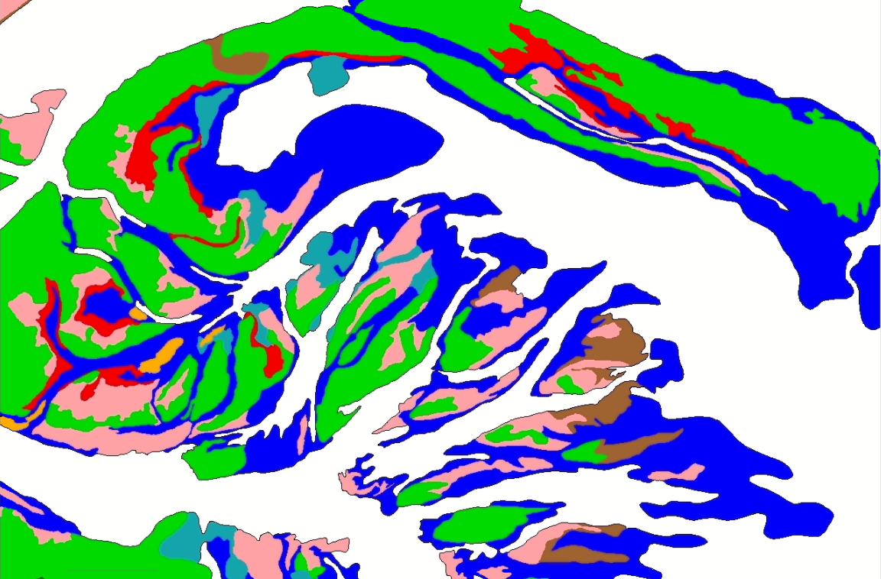
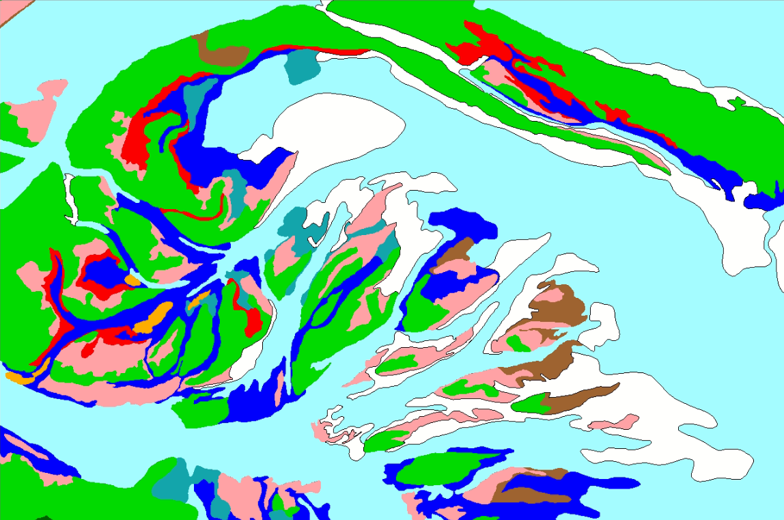
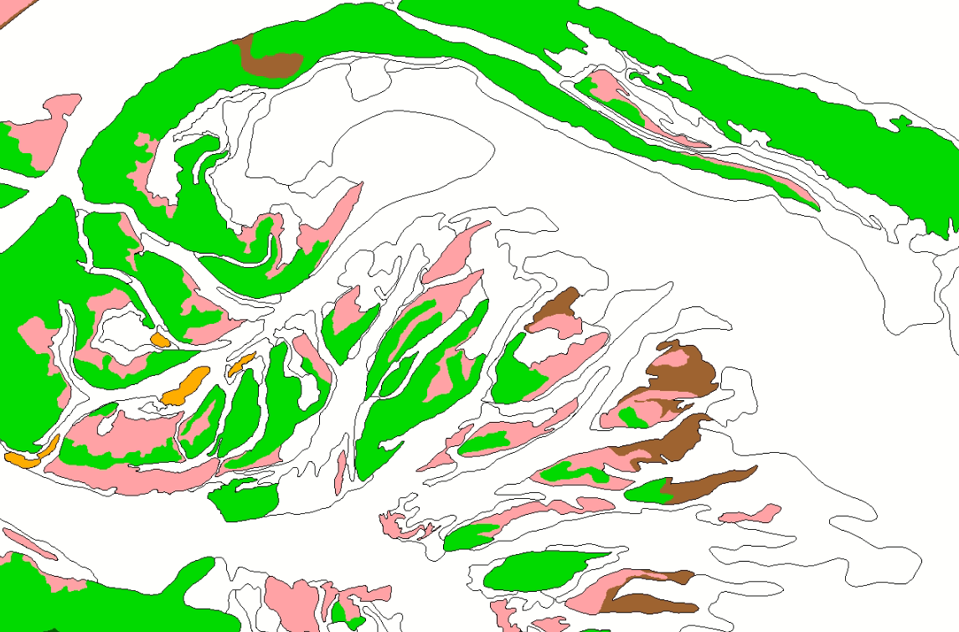
Methodology for Calculating Model Scores for Future without Water Level Management
Dabbling Duck Model, Variable 5: Percent Open Water
Acres of “Open Water”
(Acres of Open Water - unvegetated
Acres of Open Water - sparsely vegetated)
Acres of Total Aquatic Area
Percent Open Water
Pool 2
Notes:
Percentage of open water is one of the variables most likely to change due to a drawdown and most easily measurable… because the “Open Water” areas that are exposed are the areas we expect vegetation to grow. So this one was obviously very important for us to capture. To find the existing conditions, we used the Land Classification data from UMESC. We added all areas that were identified as unvegetated and those areas that were identified as sparsely vegetated (less than 33% coverage). This was then divided by the total aquatic area, which resulted in the percentage of open water.
Definition = water areas with no floating leaved aquatic or emergent vegetation present or those areas with less than 50% canopy coverage from aquatic vegetation.
Data used: Land Classifications and Acreage Amounts for each pool from the UMRR LTRM 2010 Land Cover/Use geographic shapefiles

Slide 11
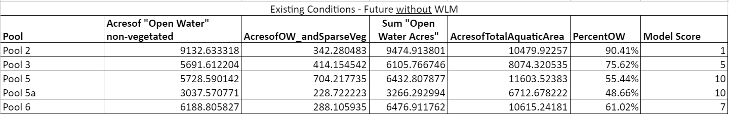
Methodology for Calculating Model Scores for Future without Water Level Management
Dabbling Duck Model, Variable 5: Percent Open Water
Definition = water areas with no floating leaved aquatic or emergent vegetation present or those areas with less than 50% canopy coverage from aquatic vegetation.
Data used: Land Classifications and Acreage Amounts for each pool from the UMRR LTRM 2010 Land Cover/Use geographic shapefiles
Acres of “Open Water”
(Acres of Open Water - unvegetated
Acres of Open Water - sparsely vegetated)
Acres of Total Aquatic Area
Percent Open Water
Model Scoring:
<10% = 1 10 - 25% = 5 25 - 40% = 7 40 - 60% = 10 60 - 75% = 7 75 - 90% = 5 >90% = 1
Example of Results:

Slide 12
Methodology for Calculating Model Scores for Future with Water Level Management
Dabbling Duck Model, Variable 5: Percent Open Water
Existing (without WLM) Acres of “Open Water”
Acres of New Emergent Vegetation
+ Acres of New Rooted Floating Aquatics
+ Acres of New Submersed Aquatic Vegetation
Acres of Total Aquatic Area
Percent Open Water
Notes:
In order to incorporate the with-project conditions, we started at the existing conditions results, and subtracted the acres of vegetation assumed to grow in response to each drawdown scenario, and re-ran the simple percentage calculation.
Definition = water areas with no floating leaved aquatic or emergent vegetation present or those areas with less than 50% canopy coverage from aquatic vegetation.
Data used:
Land Classifications and Acreage Amounts for each pool from the UMRR LTRM 2010 Land Cover/Use geographic shapefiles
Calculated Vegetation Exposure of Land Classifications after Water Level Drawdowns

Slide 13
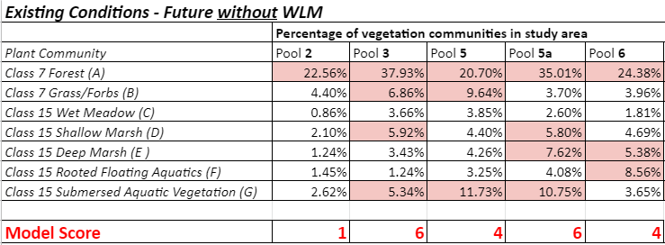
Methodology for Calculating Model Scores for Future without Water Level Management
Dabbling Duck Model, Variable 6: Plant Community Diversity
More communities = bigger score!
Acreage of distinct vegetation community
Total Study Area (Pool) Acreage
Percentage of study area consisting of distinct vegetation community
Count of Distinct Vegetation Communities 5% or greater acreage
Notes:
Very simple… more communities is bigger score! Again, used Land Class data to determine existing conditions. Pulled out report of acreage of each land class type for each pool.
“The presence of a vegetation community should not be the sole criteria in assigning the suitability index for this variable. Consideration should also be given to the extent that the different communities are present.”
In our case, we used 5% as a cutoff for including it in the scoring.
Definition = number of distinct vegetation communities present that consist of more than 5% of the study area acreage
Distinct Vegetation Communities from Land Classifications: Forest, Grass/Forbs, Wet Meadow, Shallow Marsh, Deep Marsh, Rooted Floating Aquatics, and Submersed Aquatic Vegetation
Data used: Land Classifications and Acreage Amounts for each pool from the UMRR LTRM 2010 Land Cover/Use geographic shapefiles

Slide 14
Methodology for Calculating Model Scores for Future without Water Level Management
Dabbling Duck Model, Variable 6: Plant Community Diversity
Example of Results:
Model Scoring:
0-1 vegetation communities = 1
2-3 vegetation communities = 4
4-5 vegetation communities = 6
6-7 vegetation communities = 10
Notes:
Definition = number of distinct vegetation communities present that consist of more than 5% of the study area acreage

Slide 15
Methodology for Calculating Model Scores for Future with Water Level Management
Dabbling Duck Model, Variable 6: Plant Community Diversity
Acreage of distinct vegetation community:
-Existing (without WLM) Acres of Shallow Marsh + Acres of New Emergent Vegetation
Existing (without WLM) Acres of Rooted Floating Aquatics + Acres of New Rooted Floating Aquatics
Existing (without WLM) Acres of Submersed Aquatic Vegetation + Acres of New Submersed Aquatic Vegetation
Percentage of study area consisting of distinct vegetation community
Count of Distinct Vegetation Communities 5% or greater acreage
Total Study Area (Pool) Acreage
Notes:
To incorporate the drawdown conditions, we used the same acreages of assumed aquatic veg growth, and added them to the existing acres.
So, only these three communities could be improved by the drawdown. Limiting factor. If a pool scored lower because it didn’t have forest or grasses, the assumptions we used wouldn’t allow those to be improved.
-Make equation text bigger (LH)
Definition = number of distinct vegetation communities present that consist of more than 5% of the study area acreage

Slide 16
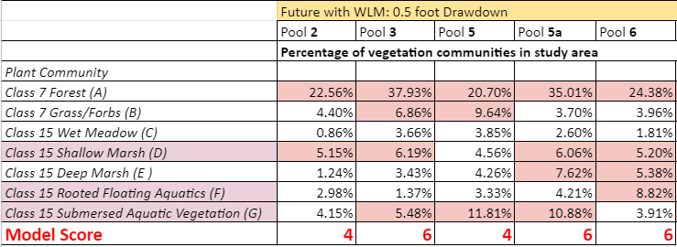
Methodology for Calculating Model Scores for Future with Water Level Management
Dabbling Duck Model, Variable 6: Plant Community Diversity
Future without WLM (Existing Conditions) Scores:
Pool 2: 1 Pool 3: 6 Pool 5: 4 Pool 5a: 6 Pool 6: 4
Future with WLM Results:
Model Scoring:
0-1 vegetation communities = 1
2-3 vegetation communities = 4
4-5 vegetation communities = 6
6-7 vegetation communities = 10
Notes:
Definition = number of distinct vegetation communities present that consist of more than 5% of the study area acreage

Slide 17
Methodology for Calculating Model Scores for Future without Water Level Management
Dabbling Duck Model, Variable 7: Important Food Plant Coverage
Part 1
“Important food species include: bidens, chufa, coontail, cutgrass, duckweeds, pondweeds, foxtail, pigweeds, ragweeds, sedges, smartweeds, spikerushes, bur-reed, arrowhead, wild rice, lotus, wigeon grass, Japanese millet, wild millet, agricultural crops and acorns.”
More beds with these species = higher score.
Notes:
Generally speaking...

Slide 18
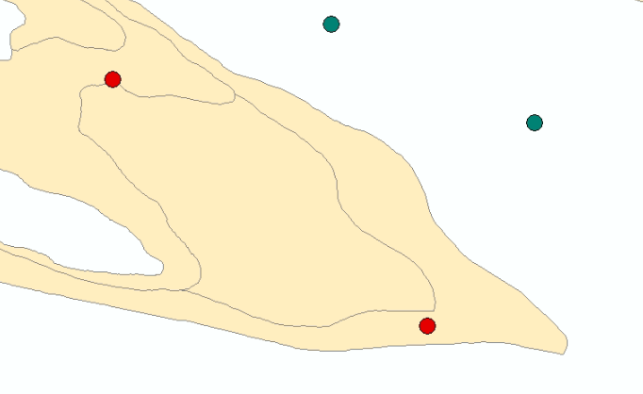
Methodology for Calculating Model Scores for Future without Water Level Management
Dabbling Duck Model, Variable 7: Important Food Plant Coverage
Part 1
Count of Vegetation Sample Points Containing any Important Waterfowl Food Plant Species that are located inside or within 20 feet of LC Vegetation Bed
Percent of Vegetation Sample Points Containing Important Waterfowl Food Plant Species in each LC Vegetation Bed
Count of All Vegetation Sample Points located inside or within 20 feet of LC Vegetation Bed
Red Points: Vegetation Sample points located inside Emergent Vegetation Bed
Circled red point: Point containing Important Waterfowl Food Species inside of a Emergent vegetation bed
Pool 11
*Visual example only, does not represent actual data
So in this hypothetical example…
1 of 2 points in that veg type contained important food species. (50%)
Extrapolated this to assume that 50% of veg beds of this type in this pool contain important food plants.
Notes:
This variable got trickier… Needed to get further down into the weeds on species, but also needed to stay at the pool level to understand the areal coverage.
Basically combining two datasets to get the needed information for this variable.
Used Land Class data to understand the greater veg bed type and the area,
And, on-the-ground veg sampling data to get to the species of interest level.
On-the-ground info came from veg surveys from LTRM and UMRCC, and tried to pull out reasonable water years, and the newest available.
GO THROUGH SLIDE EXAMPLE
We did this for each veg type to estimate the percentage of beds that contained important food species.
-Make text bigger (LH)
Definition = percentage of vegetation beds containing important waterfowl food species
Land Classification (LC) Vegetation Beds: Deep Marsh, Rooted Floating Aquatics, Shallow Marsh, Submersed Aquatic Vegetation, Wet Meadow
Data used:
Land Classifications and Acreage Amounts for each pool from the UMRR LTRM 2010 Land Cover/Use geographic shapefiles
Aquatic Vegetation Sampling for each pool from UMRCC, various years

Slide 19
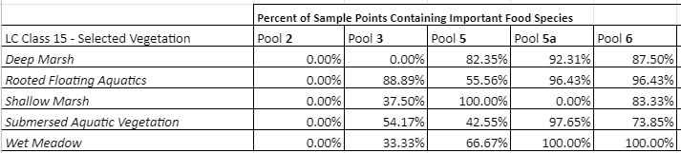
Methodology for Calculating Model Scores for Future without Water Level Management
Dabbling Duck Model, Variable 7: Important Food Plant Coverage
Part 1: Calculating Percentage of Vegetation Sample Points Containing Important Food Species

Slide 20
Methodology for Calculating Model Scores for Future without Water Level Management
Dabbling Duck Model, Variable 7: Important Food Plant Coverage
Part 2
Percent of Vegetation Sample Points Containing Important Waterfowl Food
Total Acreage of each LC Vegetation Bed
Acres of veg class containing important waterfowl food species
SUM of Estimated Number of acres of vegetation beds containing important waterfowl food species
SUM of Total Acreage of LC Vegetation Beds
Percentage of Vegetation Beds containing Important Waterfowl Food Species
Notes:
This just shows those calculations…
-Make text bigger (LH)
Definition = percentage of vegetation beds containing important waterfowl food species
Land Classification (LC) Vegetation Beds: Deep Marsh, Rooted Floating Aquatics, Shallow Marsh, Submersed Aquatic Vegetation, Wet Meadow
Data used:
Land Classifications and Acreage Amounts for each pool from the UMRR LTRM 2010 Land Cover/Use geographic shapefiles
Aquatic Vegetation Sampling for each pool from UMRCC, various years

Slide 21
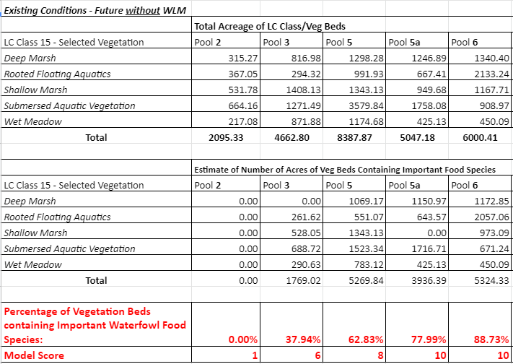
Methodology for Calculating Model Scores for Future without Water Level Management
Dabbling Duck Model, Variable 7: Important Food Plant Coverage
Part 2: Calculating Estimated Number of acres of vegetation beds containing important waterfowl food species
Model Scoring:
<10% = 1
10 - 25% = 4
25 - 50% = 6
50 - 75% = 8
>75% = 10
Notes:
Here’s an example of the results for this variable…
.

Slide 22
Methodology for Calculating Model Scores for Future with Water Level Management
Dabbling Duck Model, Variable 7: Important Food Plant Coverage = Existing / Future without WLM
Percent of Vegetation Sample Points Containing Important Waterfowl Food
Total Acreage of each LC Vegetation Bed
Acres of veg class containing important waterfowl food species
Part 2
SUM of Estimated Number of acres of vegetation beds containing important waterfowl food species
SUM of Total Acreage of LC Vegetation Beds
Percentage of Vegetation Beds containing Important Waterfowl Food Species
Acres of New Emergent Vegetation
+ Acres of New Rooted Floating Aquatics
+ Acres of New Submersed Aquatic Vegetation
Acres of New Emergent Vegetation
+ Acres of New Rooted Floating Aquatics
+ Acres of New Submersed Aquatic Vegetation
Notes:
To apply this to the drawdown results, we again added in the predicted aquatic vegetation improvements.
We’re making the assumption that all new bed acreage will include important food species. This seems extreme, but we’re also leaving out the improvements to existing beds simply because we didn’t have a good way to capture those benefits. We felt this was a good compromise. This was also based on some review of surveys conducted in areas following drawdowns in both the upper pools and the lower pools (24-26), that all included large quantities of these important food species.
Definition = percentage of vegetation beds containing important waterfowl food species

Slide 23
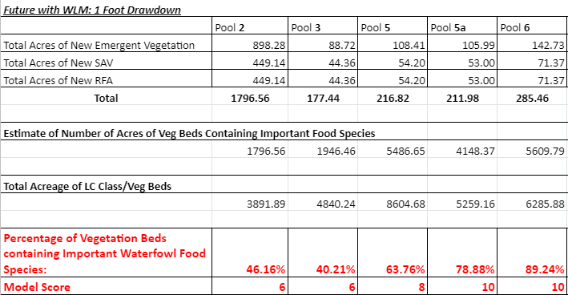
Methodology for Calculating Model Scores for Future with Water Level Management
Dabbling Duck Model, Variable 7: Important Food Plant Coverage
Future without WLM (Existing Conditions) Scores:
Pool 2: 0% = 1 Pool 3: 37.94% = 6 Pool 5: 62.83% = 8 Pool 5a: 77.99% = 10 Pool 6: 88.73% = 10
Model Scoring:
<10% = 1
10 - 25% = 4
25 - 50% = 6
50 - 75% = 8
>75% = 10
Notes:
Definition = percentage of vegetation beds containing important waterfowl food species

Slide 24
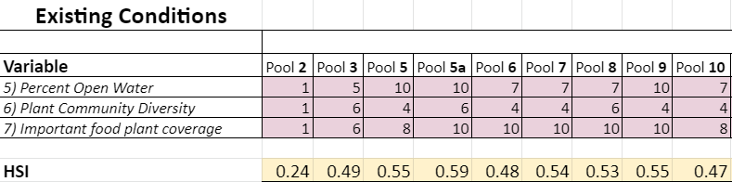
Future without WLM: Full Model Calculation Example - MVP District
Went through a lot of iterations on each of these, and tried to judge the results by whether they made sense comparatively. Made many adjustments to capture known general trends.
Notes:
Lots of numbers.
Only the three variables modified are shown here. The “HSI” is the Habitat Suitability Index result from the model. This represents the habitat conditions as a snapshot in time. For example, Pool 2’s HSI of .24 means that it is estimated to be providing about one-quarter of the habitat value that it would under best conditions.
Want you to focus on are how these change from pool-to-pool. If you watch the pools, I think they tend to capture the general trends we assume to move through the river system.

Slide 25
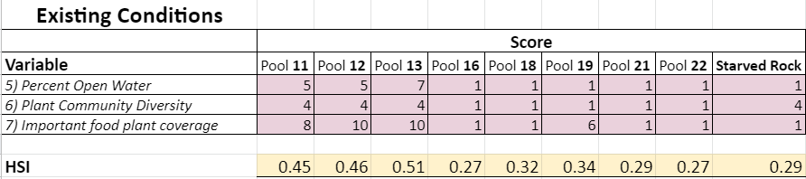
Future without WLM: Full Model Calculation Example - MVR District
Went through a lot of iterations on each of these, and tried to judge the results by whether they made sense comparatively. Made many adjustments to capture known general trends.
Notes:
Lots of numbers. Want you to focus on the two highlighted areas for these results. If you watch the pools, I think they tend to capture the general trends we assume to move through the river system.

Slide 26
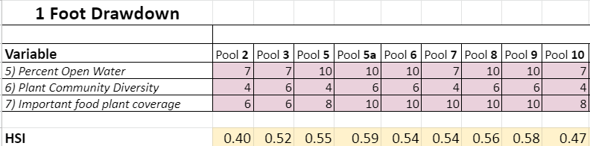
Future with WLM: 1 foot Drawdown - Full Model Calculation Example - MVP District

Slide 27
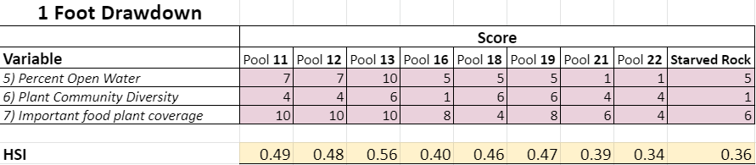
Future with WLM: 1 foot Drawdown - Full Model Calculation Example - MVR District

Slide 28
Model Results - MVP District
Habitat Suitability Index Summary | Pool 2 | Pool 3 | Pool 5 | Pool 5a | Pool 6 | Pool 7 | Pool 8 | Pool 9 | Pool 10
Existing Conditions | 0.23 | 0.49 | 0.55 | 0.59 | 0.48 | 0.54 | 0.53 | 0.55 | 0.47
1' Drawdown | 0.40 | 0.52 | 0.55 | 0.59 | 0.54 | 0.54 | 0.56 | 0.58 | 0.47
2' Drawdown | 0.42 | 0.52 | 0.58 | 0.59 | 0.54 | 0.58 | 0.61 | 0.58 | 0.47
Notes:
And here, the existing conditions are shown with the HSI values for a 1 and 2 foot drawdown.

Slide 29
Model Results - MVR District
Habitat Suitability Index Summary | Pool 11 | Pool 12 | Pool 13 | Pool 16 | Pool 18 | Pool 19 | Pool 21 | Pool 22 | Starved Rock
Existing Conditions | 0.45 | 0.46 | 0.51 | 0.26 | 0.31 | 0.31 | 0.29 | 0.26 | 0.29
1' Drawdown | 0.49 | 0.48 | 0.56 | 0.35 | 0.44 | 0.42 | 0.35 | 0.32 | 0.36
2' Drawdown | 0.49 | 0.48 | 0.56 | 0.42 | 0.51 | 0.49 | 0.41 | 0.32 | 0.45

